Slide 1
UNHCR & Resettlement
Idaho Conference on Refugees
Boise, Idaho
February 2016
Notes:
Protection
The protection of millions of uprooted or stateless people is UNHCR's core mandate.
Emergency Response
UNHCR is committed to increasing its ability to respond to complex emergency situations.
Assistance
From life-saving aid to help with shelter, health, water, education and more.
Durable Solutions
Voluntary repatriation, local integration, resettlement, the three key solutions.
Environment
How UNHCR and partners seek to minimize the environmental impact of refugee operations.
Millennium Development Goals
Refugees, asylum seekers, IDPs and the Millennium Development Goals

Slide 2
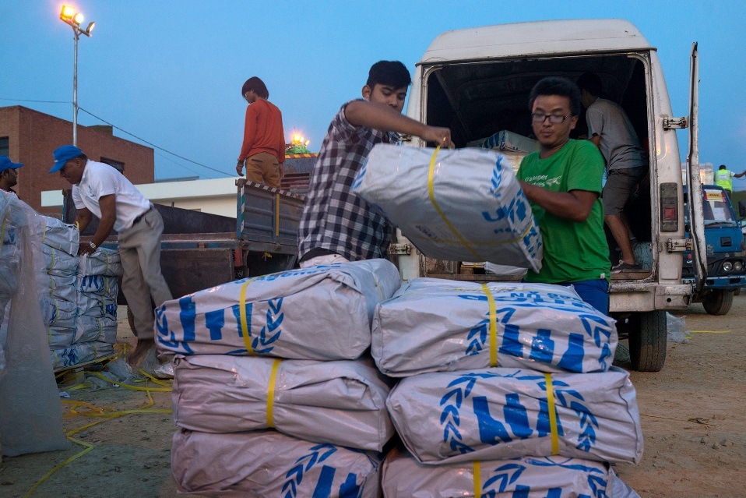
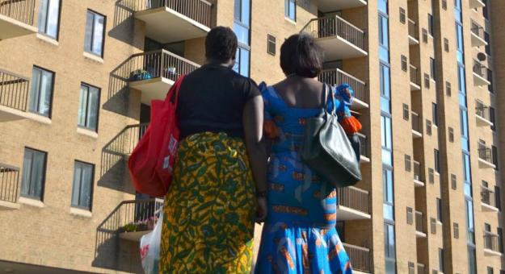
The Work of UNHCR
Assistance
Protection
Solutions

Slide 3
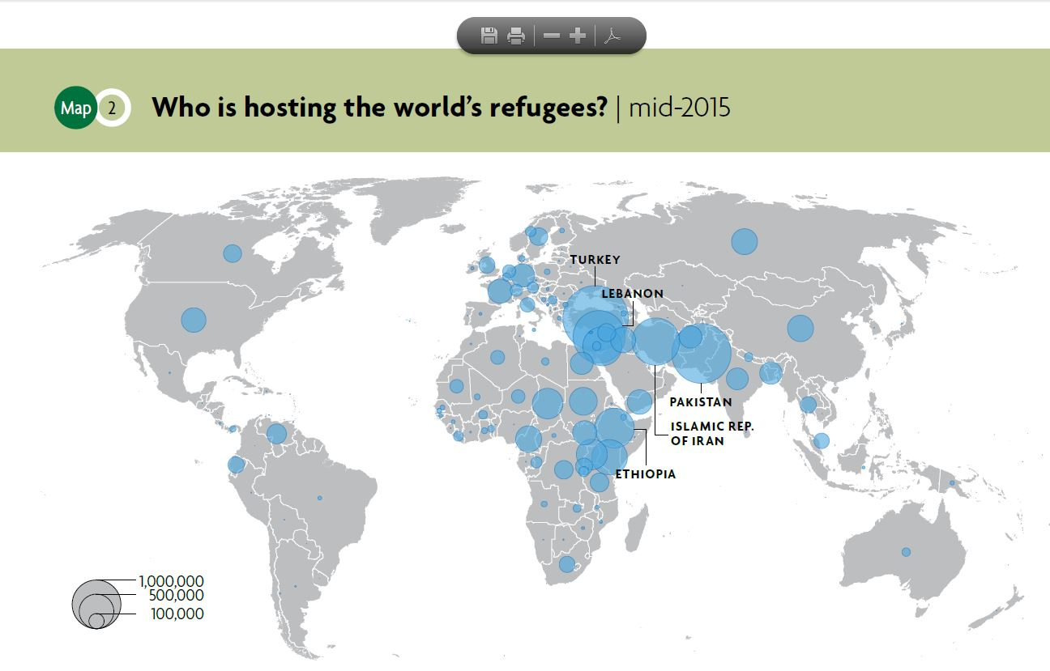

Slide 4
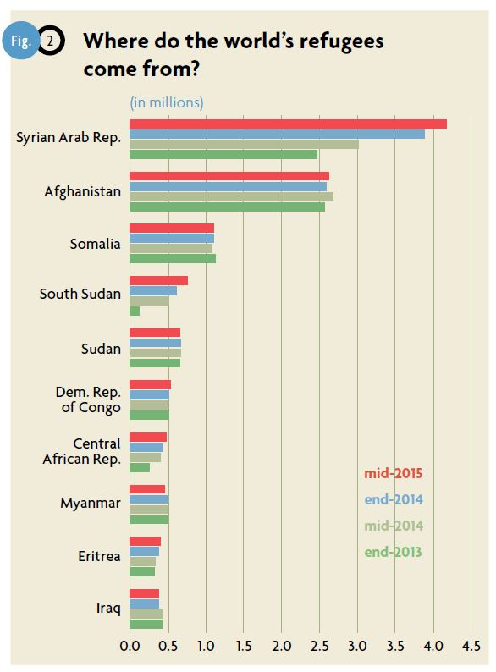

Slide 5
What is Resettlement?
Resettlement involves the selection and transfer of refugees from a country in which they have sought protection to a another country which has agreed to admit them as refugees.
Resettlement is used to protect the most vulnerable refugees, to reunite families, to provide a durable solution to refugees, and in protracted situations. It is another way to show support to countries hosting refugees.
Notes:
Discuss temporary stays, etc.

Slide 6
Steps for Refugee Resettlement
Registration
Resettlement country
refugee status determination
and admissibility
procedures
Refugee status
determination
Interview and Submission
Security & medical
clearances
Identification of a
need for resettlement
Travel
Reception & Integration

Slide 7
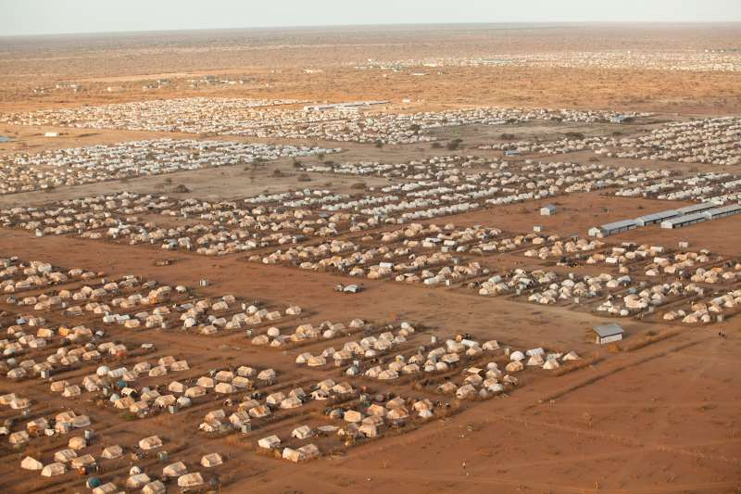
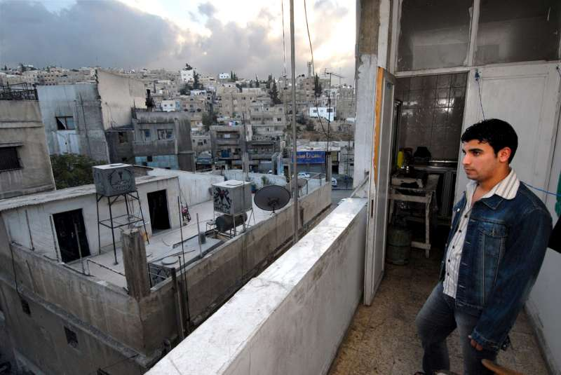
Identification of Refugees in Need of Resettlement
Notes:
Do this by working with NGO’s, staff, looking at our records.

Slide 8
UNHCR Resettlement Categories
Legal or Physical Protection (35%)
Survivors of Violence or Torture (19%)
Women and Girls-at-Risk (12%)
Medical Needs (1-2%)
Family Reunification (1-2%)
(minor) Children and Adolescents (1-2%)
Lack of Foreseeable Alternative Durable Solutions (30%)
Notes:
Talk about how Caribbean is different. Partners comments, information from RSD,

Slide 9
UNHCR Global Resettlement
Submissions and Departures, 2012-2015

Slide 10
UNHCR Global Submissions by Country of Asylum

Slide 11
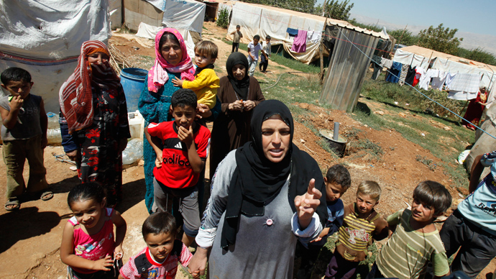
Syrian Refugees
4.5 million refugees – largest refugee situation in decades
Main countries of asylum – Egypt, Iraq, Jordan, Lebanon, Turkey
80 % are women or children
40 % are under 12 yrs of age
Less than 15% live in camps
99% registered with iris scans
Source: http://data.unhcr.org/syrianrefugees/regional.php
Notes:
Nearly two-thirds of refugee receiving countries are also among the poorest countries in the world (UNDP)

Slide 12
Resettlement of Syrian Refuges
Estimated 10% of Syrians will ultimately need resettlement
165,000 resettlement places pledged to date
Only refugees in Middle East registered with iris scans or fingerprints are referred (not from Europe.)
Average time from registration to a resettlement interview is 3 years.
Average time for UNHCR resettlement interview and decision 90 days (if approved).
Average time from UNHCR referral to resettlement to the US 18-24 months (if approved).
Notes:
Nearly two-thirds of refugee receiving countries are also among the poorest countries in the world (UNDP)

Slide 13
UNHCR Submissions and Departures of Refugees from Syria, 2013

Slide 14
UNHCR Submissions and Departures of Refugees from Syria, 2013 through 2014

Slide 15
UNHCR Submissions and Departures of Refugees from Syria, 2013 through 2015

Slide 16
UNHCR Submissions and Departures of Refugees from Syria, 2013 through Feb 5, 2015

Slide 17
Germany
All Others
All Others
Australia
Switzerland
Netherlands
Belgium
Ireland
Czech Rep.
Denmark
Iceland
Italy
Luxembourg
New Zealand
Spain
Belarus
Brazil
Hungary
Liechtenstein
Uruguay
Norway
United States
Sweden
France
Canada
United Kingdom
Finland
Austria
Syrian resettlement by country end of 2015 – Proportional representation

Slide 18
Resettlement of (D.R.) Congolese
Multiple year agreement with the US to refer 50,000 Congolese in Burundi, Rwanda, Tanzania and Uganda.
Focus is on refugees from Eastern provinces in DRC who have experienced ethnic persecution and multiple displacements.
Over 40,000 Congolese have been referred to the US program since 2012 and about 15,000 persons have arrived.
Others resettling Congolese: Australia, Belgium, Chile, Denmark, Finland, France, Germany, Iceland, Ireland, Monaco, Netherlands, New Zealand, Norway, Portugal, Sweden, Switzerland and United Kingdom.

Slide 19
UNHCR Submissions of Congolese to All Countries
2012-2015

Slide 20
Thank you Idaho!
Thank you for helping to provide refugees and their families opportunities to rebuild their lives.

