Slide 1
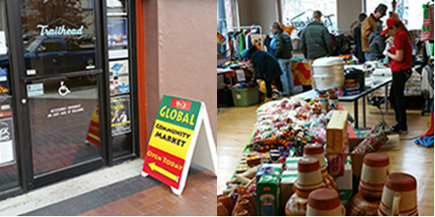
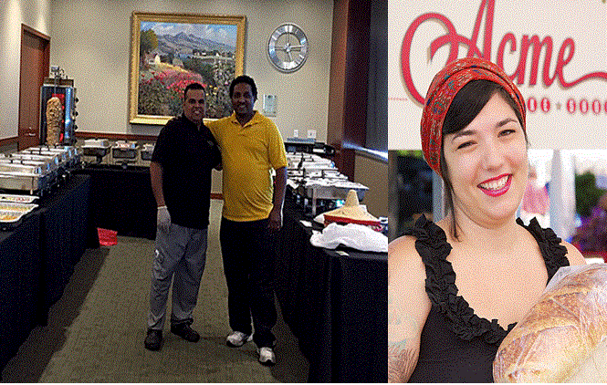
Welcome

Slide 2
Introductions
Name
What drew you to this workshop?
One word to describe what you think or feel about creating economic opportunity
Organization affiliation, if any

Slide 3
Agenda
Learning Objectives
Economic Opportunity
Financial Capability
Equality and Equity
Jannus/EO Overview
Services
Impact
Q+A

Slide 4
Learning Objectives
What is Economic Opportunity and why does it matter?
How are equality and equity different and why is this important?
What is the Jannus EO Program—what does it do, who does it serve, how can it help?

Slide 5
Economic Opportunity
The Economic Opportunity Act (EOA) of 1964 was the centerpiece of the “War on Poverty”
From onset Republicans and many Southern Democrats attempted to dismantle the EOA
Congress repealed the EOA in 1981
Source: http://business.laws.com/economic-opportunity-act

Slide 6
Economic Opportunity
A number of programs established by the act have survived to present day
Current federal focus:
Raising the Minimum Wage
Providing High Quality Early Education
Creating Pathways to Jobs
Supporting Strong Families
Increasing Access to Healthy Food
Increasing Financial Literacy
Source: https://www.whitehouse.gov/issues/urban-and-economic-mobility/economic-opportunity

Slide 7
Economic Conditions
Overall poverty rate for 2014 was 14.8%
Poverty rate by race for 2014
Whites: 10.1%
Blacks: 26.2%
Hispanics: 23.6%
Asians: 12%
2014 poverty rate for refugees: 44%
Sources: Income, Poverty, and Health Insurance Coverage in the United States, 2014, U.S. Census Bureau; The Integration Outcomes of U.S. Refugees, Successes and Challenges, 2015 Migration Policy Institute

Slide 8
Economic Conditions
United Way ALICE Project (Asset Limited, Income Constrained, Employed)
Idaho-at-a-Glance (2013)
15% (87,233 households) live in poverty
22% (130,397 households) are ALICE
Survival budget single adult: $16,660 ($5,170 above Federal Poverty Limit)
Survival budget family 2 adults/1 infant/1 toddler: $46,176 ($22,626 above Federal Poverty Limit)
Sources: United Ways of the Pacific Northwest, ALICE: Asset Limited, Income Constrained, Employed, Study of Financial Hardship; https://aspe.hhs.gov/2013-poverty-guidelines

Slide 9
Equality and Equity
Equality: the quality or state of having the same rights, social status, etc.
Equity: fairness or
justice in the way people are treated
Source: Merriam Webster; Photo: Image adapted from image adapted by the City of Portland, Oregon, Office of Equity and Human Rights from the original graphic: http://indianfunny picture .com/img/2013/1/Equality-Doesn’t-Means-Justice-Facebook-Pics.jpg

Slide 10
Financial Capability
The capacity, based on knowledge, skills, and access to manage financial resources effectively
Source: BUILDING FINANCIAL CAPABILITY A Planning Guide for Integrated Services. Prepared by CFED under the ASSET Initiative Partnership for the Administration for Children and Families at the US Department of Health and Human Services

Slide 11
Approaches to Service Integration
Source: BUILDING FINANCIAL CAPABILITY A Planning Guide for Integrated Services. Prepared by CFED under the ASSET Initiative Partnership for the Administration for Children and Families at the US Department of Health and Human Services

Slide 12
Jannus Overview
Vision
Building hope and opportunity for individuals, families and communities.
Mission
Jannus, Inc. brings people together to change lives by promoting community health, advancing public policy and creating economic opportunity.
Focus Areas
Economic Opportunity
Public Policy
Community Health

Slide 13
EO Overview
Purpose
The EO Program of Jannus provides financial capability services for clients to:
Possess knowledge
Access tools and resources
Confidently take effective action
Best fulfill personal, family and community goals
Services
Asset Business Business Credit Financing Technical Workforce
Development Planning Consulting Building Assistance Development

Slide 14
EO Overview
Competencies
Clients served are socially or economically disadvantaged and include women, Latinos, Native Americans, immigrants and refugees
Culturally informed service
Modified trainings to meet the needs of people with varying educational backgrounds, languages (with interpreters), and literacy levels
Projects
Individual Development Account
Financial Capability
Financing
Global Gardens
Global Talent Idaho
Refugee Childcare Business Development
Women’s Business Center

Slide 15
Asset Development
Basic financial education
One-on-one coaching
Matched savings
Financing
Business loans
Credit builder loans
Personal loans
Business Planning
Market research
Positioning
Financial viability
Technical Assistance
Registering, Licensing, Permitting
Taxes
Insurance
Business Consulting
Marketing
Finance
Operations
Workforce Development
Career counseling
Cultural orientation
Training
Mentoring, networking and internships
Credit Building
Credit education
One-on-one coaching
Credit builder tools

Slide 16
EO Overview
Asset Development
Basic financial education
One-on-one coaching
Matched savings
Business Planning
Market research
Positioning
Financial viability
Business Consulting
Marketing
Finance
Operations
Credit Building
Credit education
One-on-one coaching
Credit builder tools
Financing
Business loans
Credit builder loans
Personal loans
Technical Assistance
Registering, Licensing, Permitting
Taxes
Insurance
Workforce Development
Career counseling
Cultural orientation
Training
Mentoring, networking and internships

Slide 17
Market Analysis
Commissioned study of “economic leakage” in Ada and Canyon counties
Understand the opportunities for micro-enterprise and small business development in Treasure Valley
Focus on locally owned and import substituting (LOIS) versus “attract and retain” outside businesses
Mechanism for business and job creation

Slide 18
Social Enterprise
Centered around Global Community Market
Hub for colocation of workforce development, business development, and service delivery
Provides socially and economically disadvantaged clients tools and resources for financial capability
Includes community gathering space for social integration
Engages community partners

Slide 19
Outputs & Outcomes
Refugee Business Statistics (Since 2002)
420 New Businesses Starts
630 Jobs Created 176 small business loans with $950,000 disbursed
95% Loan Repayment Rate
Most Common Types of Business Starts:
Transportation including trucking, medical, and taxi
Retail and grocery Stores
Child care
Restaurants, mobile food
Car repair shops
Small farms

Slide 20
Outputs & Outcomes
Individual Development Account
74 post secondary education (since 2007)
71 microenterprise (since 2007)
145 vehicle purchases (since 2007)
109 home purchases (since 2001: asset value $12,693,359.17)
Global Talent Idaho (Since 2015)
24 job seekers placed into skilled positions
Average annual income gain of $18,568 (304% over pre-placement earnings)
$445,635 in economic impact
Global Gardens (Since 2004)
9 refugee-owned farms created; average sales of $5,623 per farmer
15 Native American hoop houses in production
1 Duck Valley Farmers Market launched

Slide 21
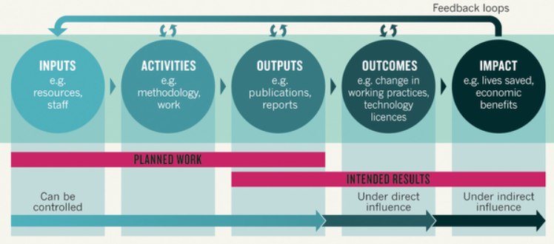
Outputs, Outcomes and Impact
OUTPUTS tell us what has occurred
OUTCOMES identify changes because of a program
IMPACTS tell us how a program might have affected participants’ lives on a broader scale
Sources: http://nonprofitanswerguide.org . Illustration used with permission from Nature Publishing Group License Number: 3802611346635 from Research impact: Income for outcome authored by Branwen Morgan, 2014.

Slide 22
Q + A

Slide 23
What’s Next?
Lending Products Implementation
EO Launch and Market Analysis: March 16-17
Global Community Market: Temp to Perm Home Social Enterprise Hub Development
Funding
Location
Phased implementation

Slide 24
Contact Info
Beth Geagan
Economic Opportunity Director & Chief Strategy Officer bgeagan@jannus.org
Gina Bessire
Project Manager, Native American Liaison gbessire@jannus.org
Kate Nelson Project Manager, Refugee Liaison
knelson@jannus.org

