Slide 1
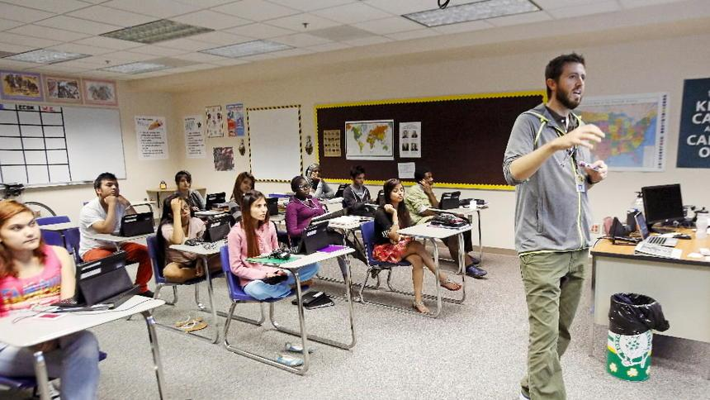
Refugee Issues for Educators
Lana Radosavljevic, MA
RCO Board Member
Jessica Marks, MPA
RCO Director

Slide 2
Mission
The RCO uses technology to facilitate successful resettlement transitions by strengthening access to resources and helping refugees build community through shared resources.

Slide 3
Agenda:
Refugee Issues for Educators: Online Course
Understanding Resettlement and the Refugee Experience
Cultural Competency
Understanding Trauma
Working with EL Students
Strategies in the Classroom
Family Engagement

Slide 4
Why?
Lack of Available Training
55% of teachers
had no refugee training
Existing trainings are
expensive

Slide 5
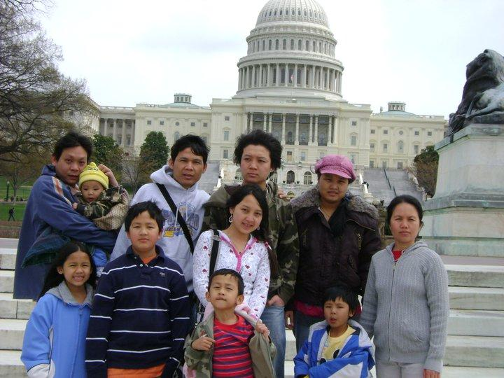
Why?
Education is a key indicator of integration
-Families Arrive with High Hopes
-Pathway to Success
-American Dream

Slide 6
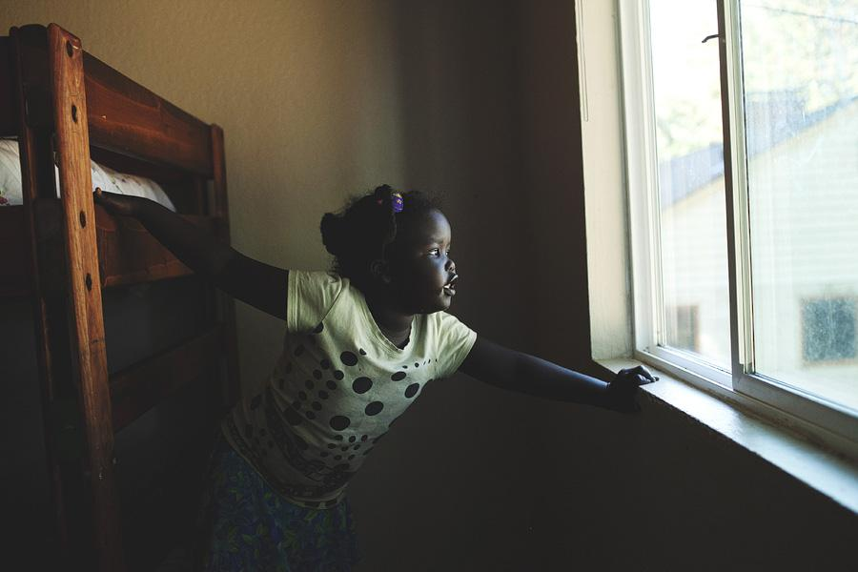
Understanding Refugee Student Experiences
Refugee Experience
Notes:
pg.15 1-2 keys tips from each unit

Slide 7
Refugee Student Surveys
Refugee Experience
-8 Locations Across the US (Rural & Urban)
-120 Middle & High School Refugee Students
-Burmese, Karen, Nepali, Bhutanese, Bangladeshi, Somali, Ethiopian, Congolese, Ugandan, Vietnamese, Mexican, El Salvadoran, Honduran, Iraqi, Afghani, and Ukranian
Notes:
pg.15 1-2 keys tips from each unit

Slide 8
Refugee Experience
When students start school in the US,
44% felt lonely
49% felt scared
50% felt confused
25% felt welcome
19% felt safe
13% felt proud
8% felt confident
28% felt interested in school

Slide 9
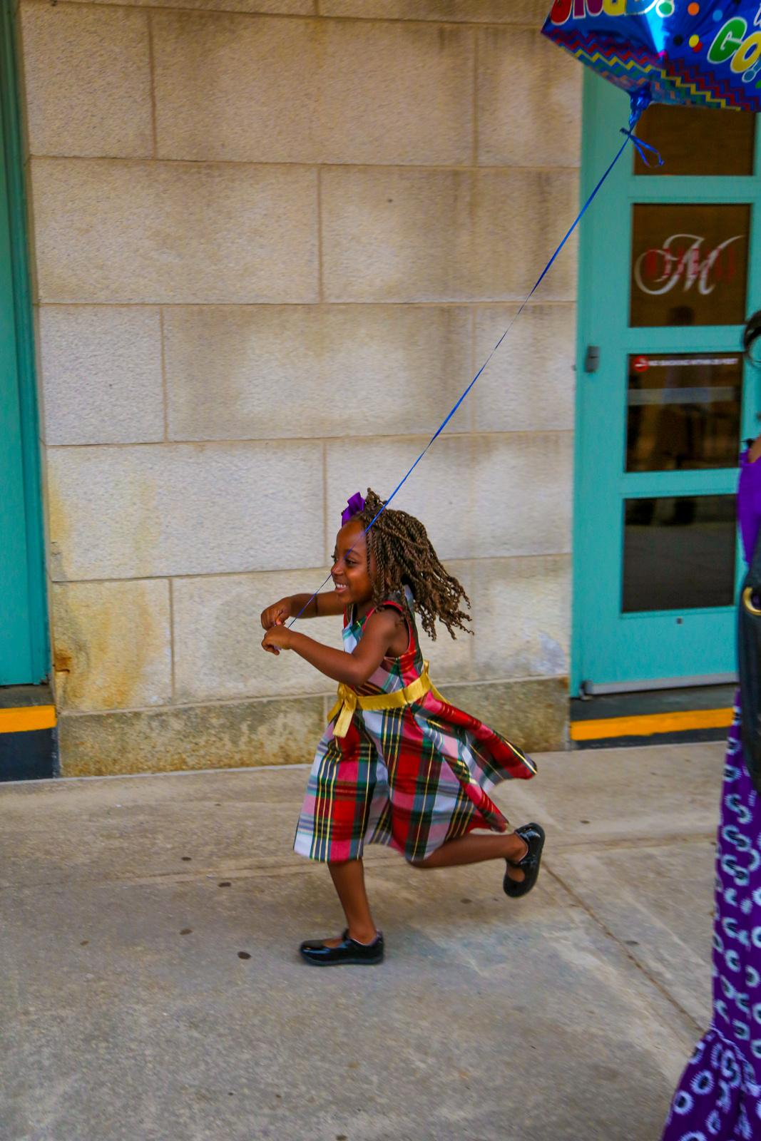
Refugee Experience
When asked how they feel today,
60% felt happy at school
10% felt lonely
9% felt confused
Photo by Molly Haley

Slide 10
Refugee Experience
Areas of concern:
• Only 27% reported feeling welcome in their overall school
• Just 32% felt confident
• Only 38% reported feeling proud
• Only 40% reported feeling interested in school

Slide 11
Refugee Experience
Refugees said their teachers were Good at the following:
80% = Including them in class discussions
86% = Spending extra time helping them with classwork
74% = Introducing them to other students
90% = Showing them how to things when they don’t understand
93% = Helping them learn English
89% = Helping them learn the rules of the classroom

Slide 12
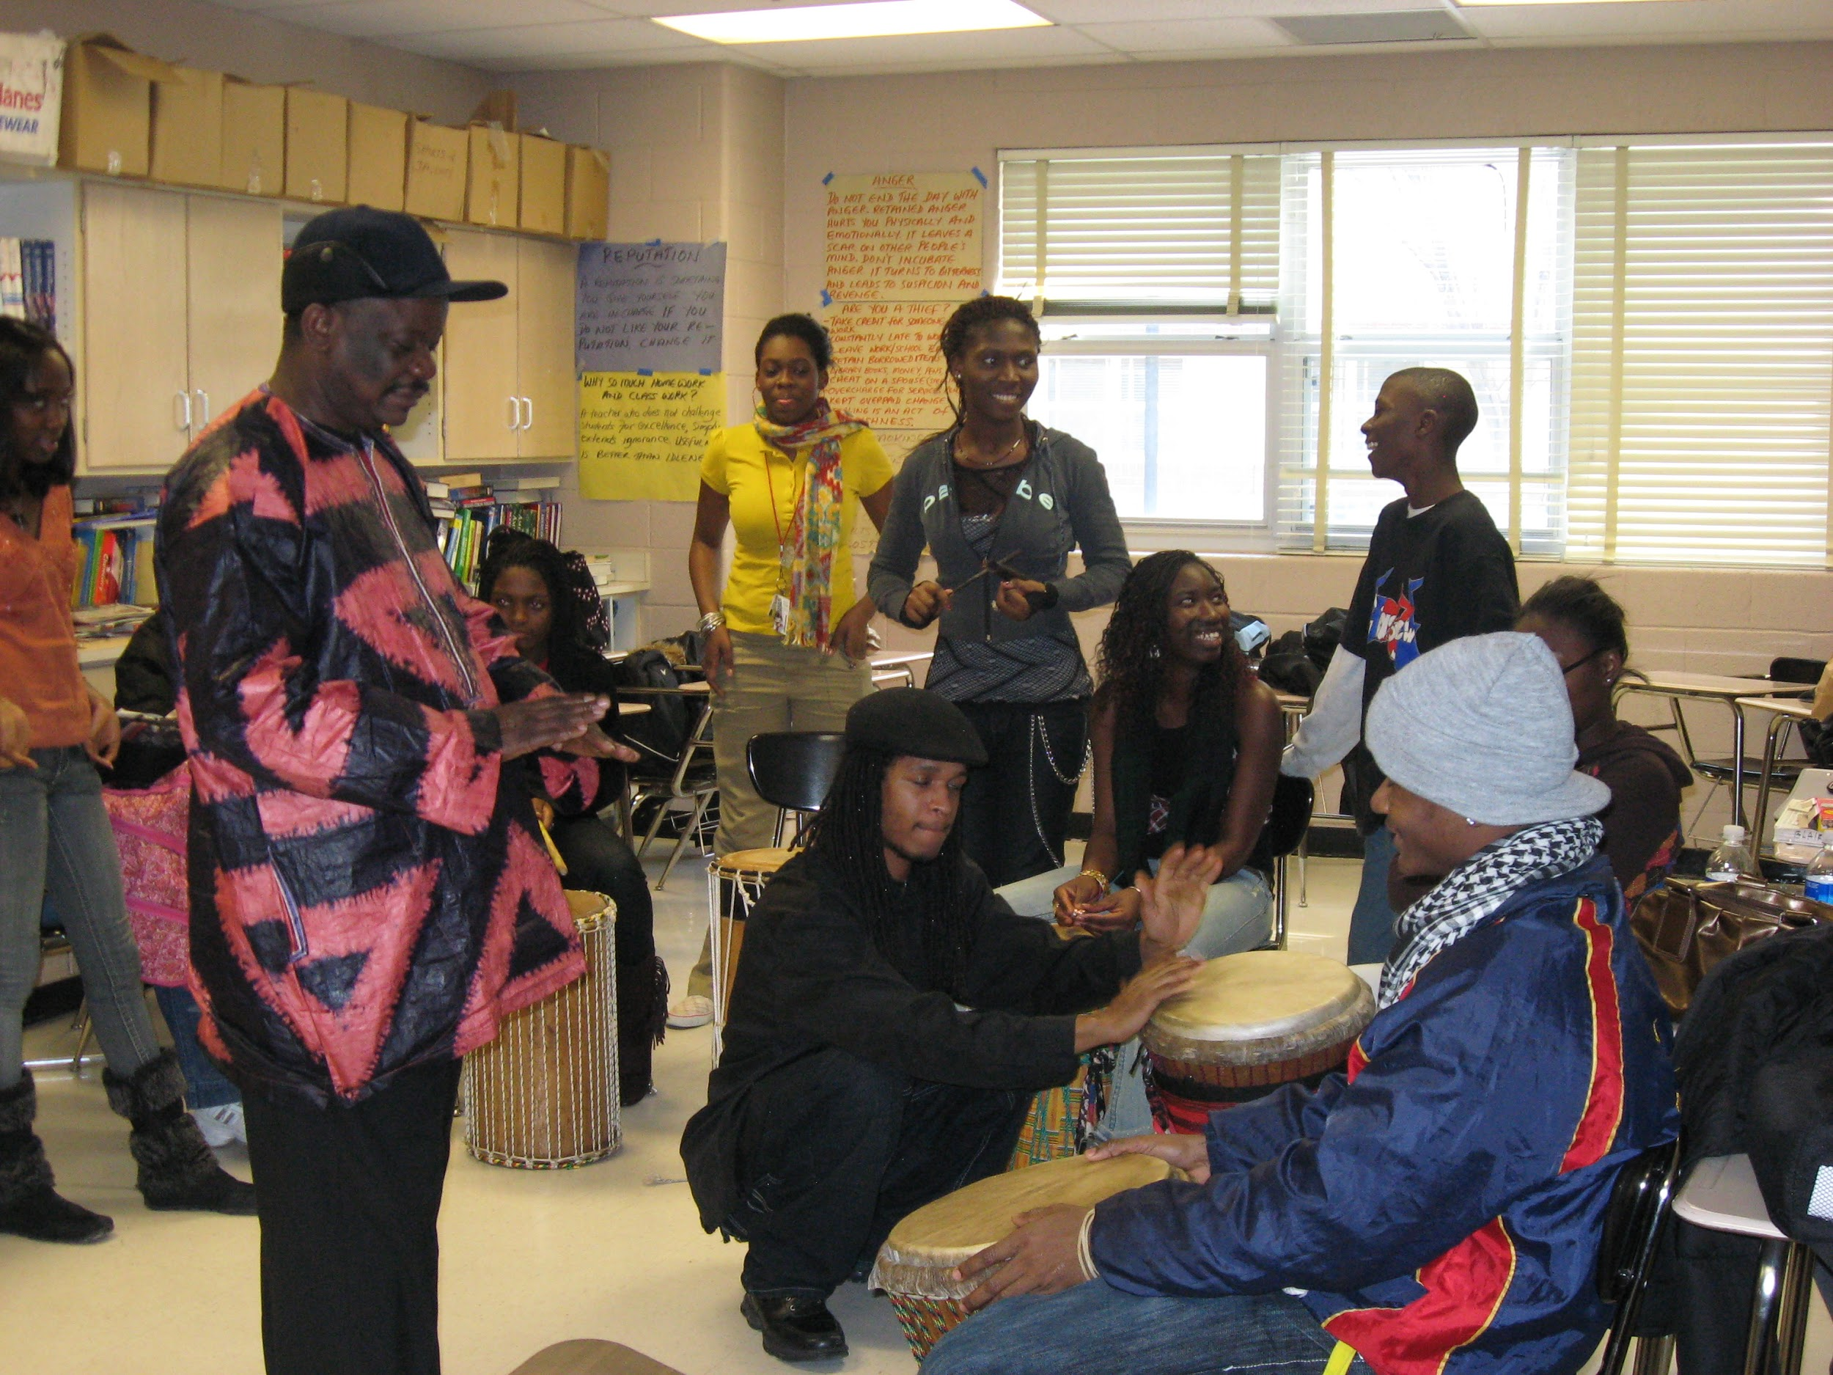
Refugee Experience
93% of refugee students reported they like and respect their teachers.

Slide 13
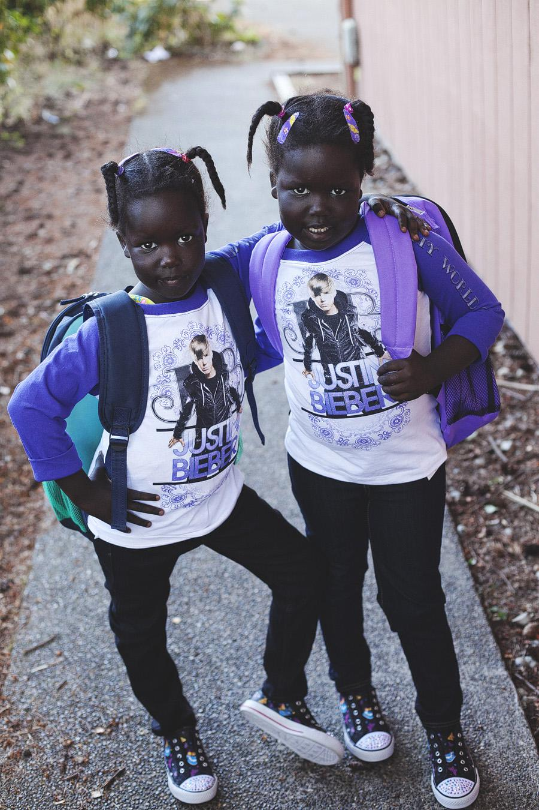
Yet, many refugees students report their teachers don’t understand them or their story:
Refugee Experience
38% - Country’s history
36% - Story of coming to the US
36% - Their lives today
44% - Culture

Slide 14
Working with EL Students
Goals
Understanding some common EL teaching myths
Identify student’s grade level
Recognize behavioral issues that often arise from linguistic frustration
Provide a welcoming environment

Slide 15
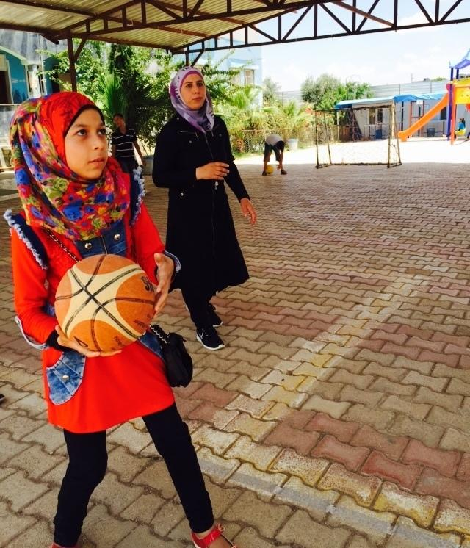
Working with EL Students
Common Instruction Myths
Students will absorb a language more quickly in a fast-paced classroom
Younger students learn English more quickly than teenagers or adults
Students should be encouraged to speak English starting the first day in the new classroom

Slide 16
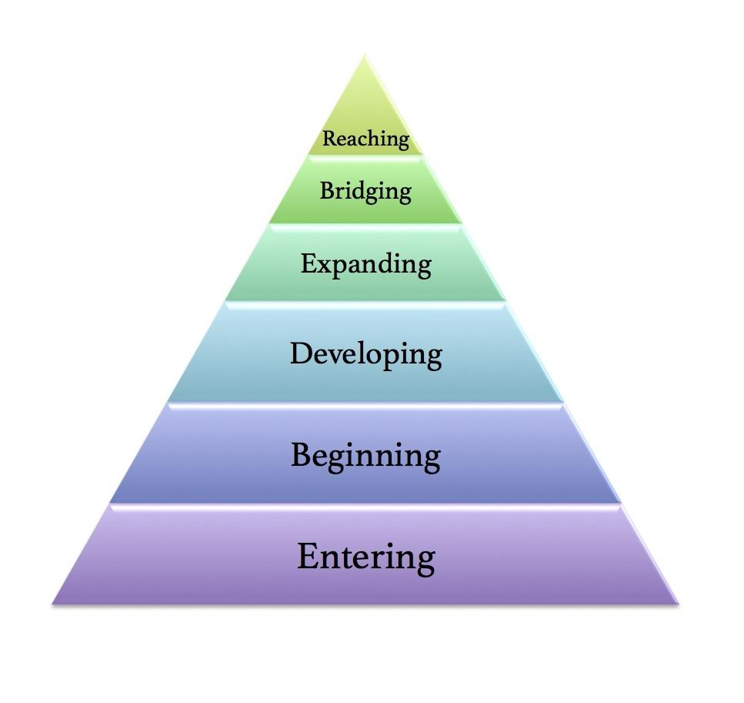
Learn: Stages of Learning
Working with EL Students
1. Entering: students are silent, respond to visuals, many grammatical errors
TIPS: speak slowly and repetitively (not louder), learn foreign words
2. Beginning: 6 months to a year, 1000 word vocabulary, continued writing errors
TIPS: Ask questions with an option, such as, “Is it the ___ one or the ___ one?”, give directions one step at a time, accept 1-2 word responses

Slide 17
Working with EL Students
Stages of Learning
3. Developing: longest stage, simple phrases used, initiate conversation
TIPS: use interactive journals, challenge without frustrating
4. Expanding: willing to express opinions, perform at grade level in science/ math
TIPS: Challenge their writing to include a variety of sentence lengths and more descriptive vocabulary

Slide 18
Working with EL Students
Stages of Learning
5. Bridging: can take four to ten years, gaps in cultural knowledge exist
TIPS: Continue to provide support for complex content, but teach and assess as you would traditional students
6. Reaching: able to communicate like peers, some gaps in cultural knowledge
TIPS: Expect same performance as peers

Slide 19
Bilingualism and Classroom Activities
Working with EL Students
* Bilingual children learn quicker and are more adept at higher order thinking skills
Helps children adjust to new situations
Makes English instruction more comprehensible
Speeds up acquisition of English

Slide 20
Working with EL Students
Bilingualism TIPS:
Use group work strategically: heterogeneous vs. homogenous
Content-based language instruction: include content & language objective
Set clear expectations: about when to use each language
4. Allow students to translanguage: bilingual literature, glossaries, visuals

Slide 21
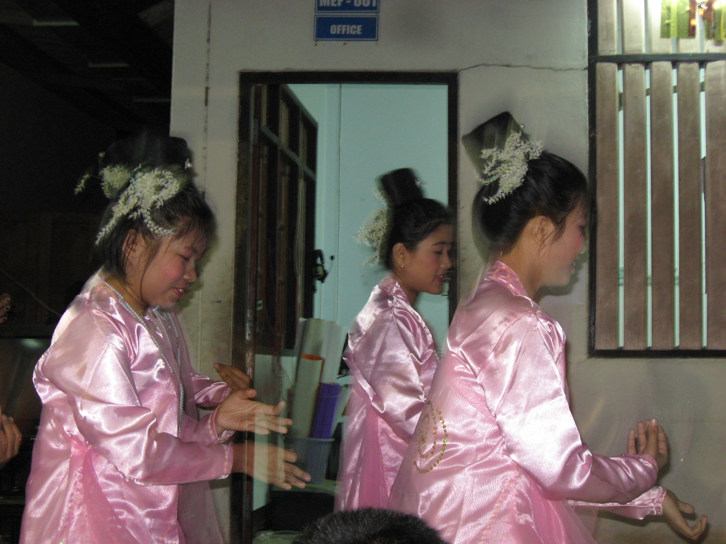
Cultural Competency
Goal: Gain Cross-Cultural Competence
What is cultural humility?
What mindset, skills and attitude do you need?

Slide 22
Cultural Competency
LEARN: Big “C” and Little “c” Culture
Big “C”
Obvious, Accessible
Language
Food
Holidays
Religion
Little “c”
How to behave
Nonverbal
Conflict management
Meaning

Slide 23
Cultural Competency
TIP: Practice Your Communication Skills
Language
Background
Indirect
-Suggestion
-Implication
-Nonverbal behavior
Direct
-Explicit
-Little reliance on context
Let’s Practice Indirect Communication:
-Say No
-Save Face

Slide 24
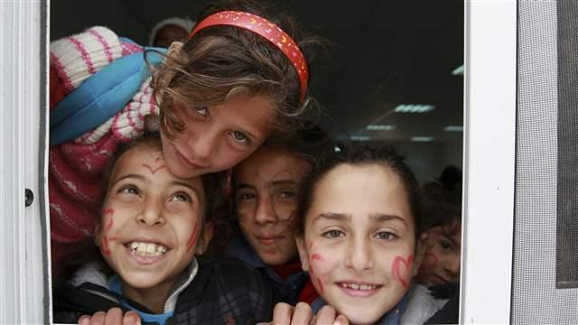
Goal
Strategies in the Classroom
Helping students identify and take pride in their existing assets
Notes:
PRINT AS HANDOUT

Slide 25
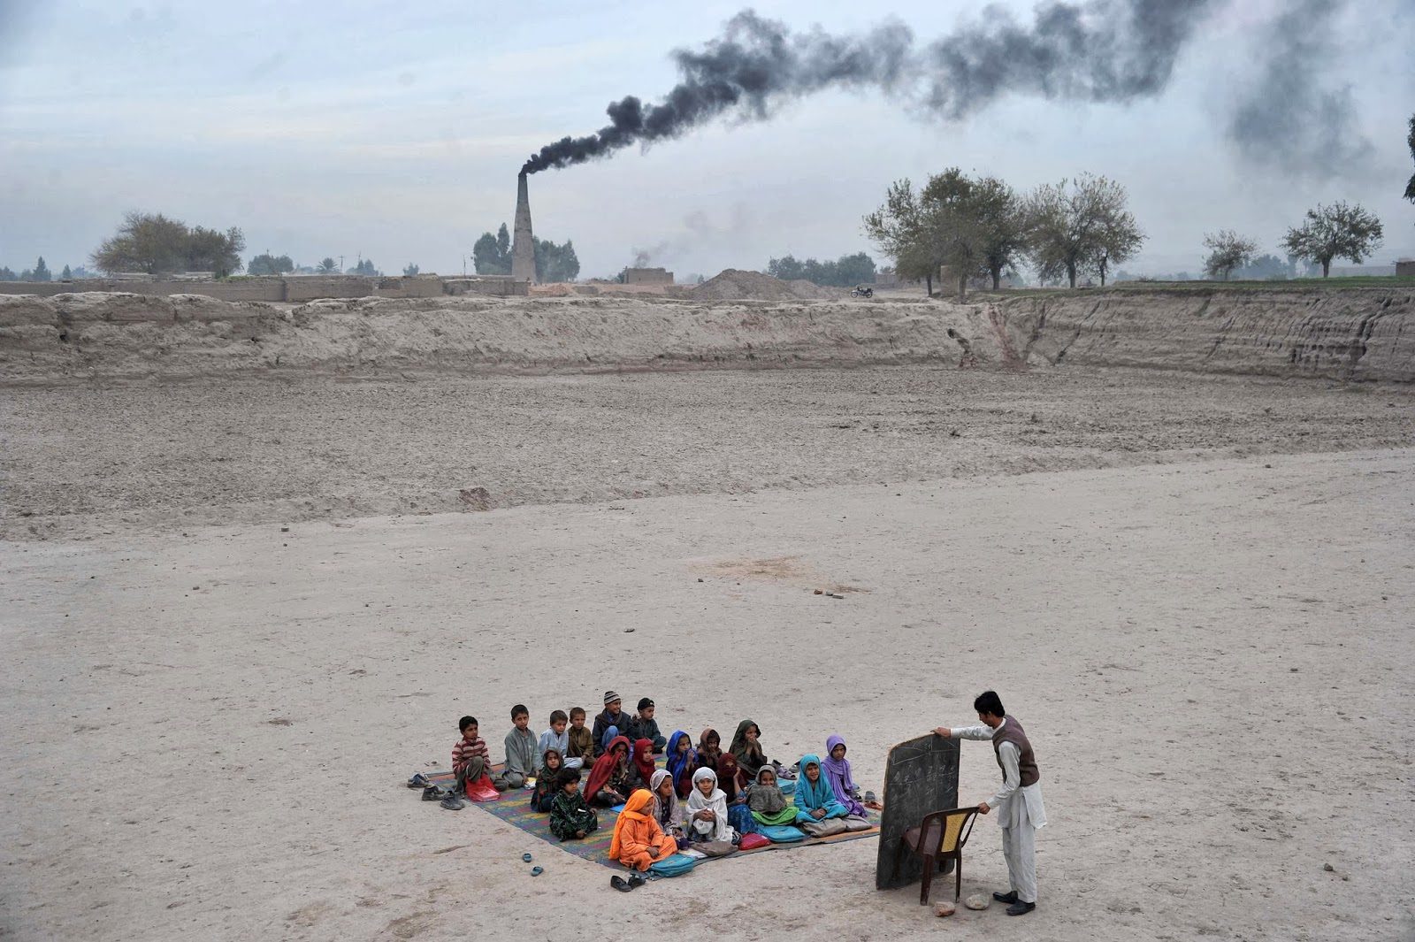
Refugee Assets in the Classroom
Strategies in the Classroom
Can you think of assets unique to refugee students?

Slide 26
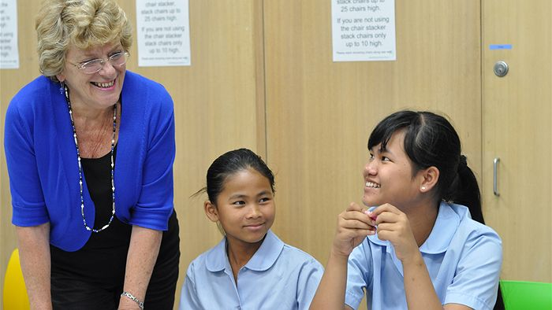
Refugee Assets in the Classroom
Strategies in the Classroom
Community: collectivist, moderators
Food: knowledge about science, nutrition
Cross- cultural communication: non verbal and verbal language

Slide 27
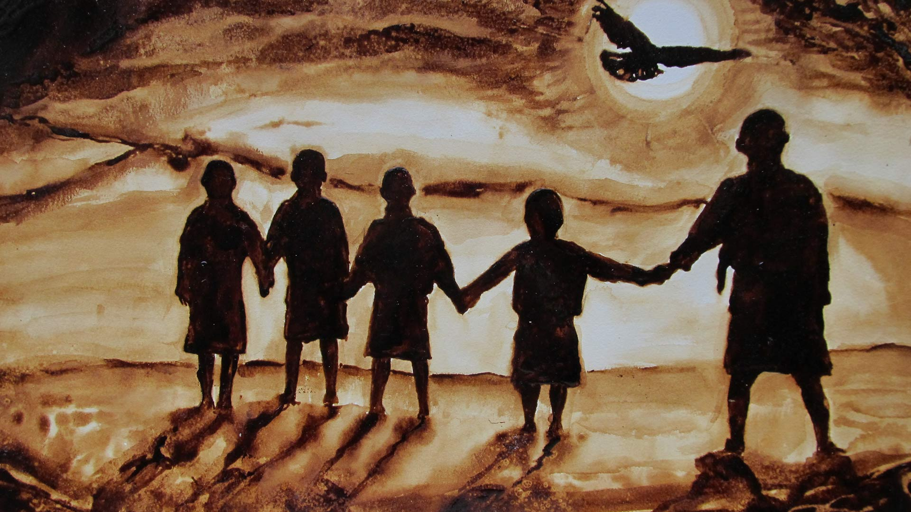
Refugee Assets in the Classroom
Strategies in the Classroom
https://www.youtube.com/watch?v=o2zA9r4UHrk

Slide 28
Strategies in the Classroom
TIPS
Complete cultural privilege assessment/walk
Digital storytelling
Culture sharing: potlucks, music, holidays
Career planning assistance

Slide 29
Trauma
Goal: Understand Trauma and Support Students with Trauma
What are trauma risk factors?

Slide 30
Trauma
LEARN: Trauma Expressed in the Classroom
Anger or Aggression
Easily Frustrated
Withdrawn
Lethargic
Poor time management

Slide 31
Trauma
TIPS: Responding to Trauma
Respond to Flashbacks
-Grounding through hyper-awareness
Respond to Panic Attacks
-Simple Tasks
Respond to Anger
-Role play ahead
-Switch to physical activity
Let’s practice!

Slide 32
Goals
Family Engagement
Understand refugee family barriers to engagement
Connect with refugee parents to support refugee student success

Slide 33
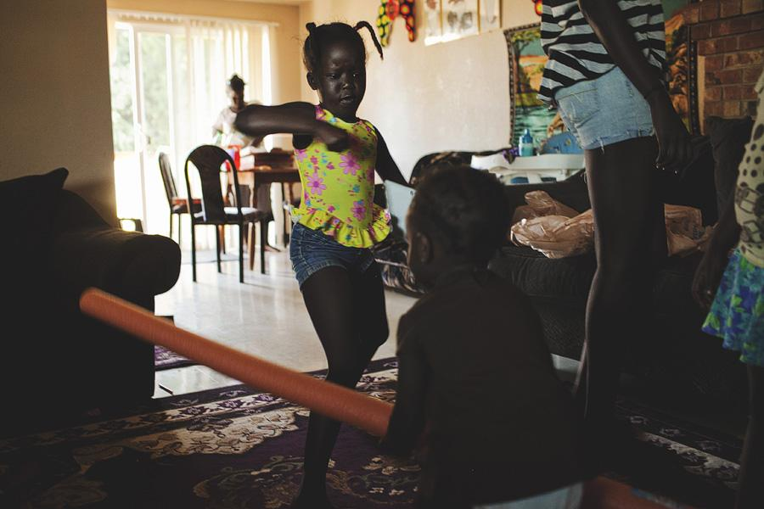
Understanding Barriers to Refugee Engagement
Family Engagement
Cultural assumptions: parents show respect by not questioning teachers and keeping their distance; May feel threatened
Language barriers: can cause embarrassment when children translate
Logistical challenges: lack of transportation, limited technology, and work schedules

Slide 34
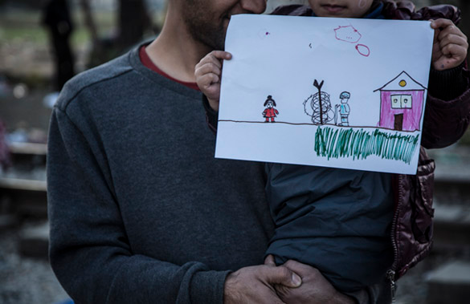
Engaging Parents: TIPS
Family Engagement
Messaging: “Being an active participant in your child’s education will help your child succeed.”
Communication
Translation
Interviews

Slide 35
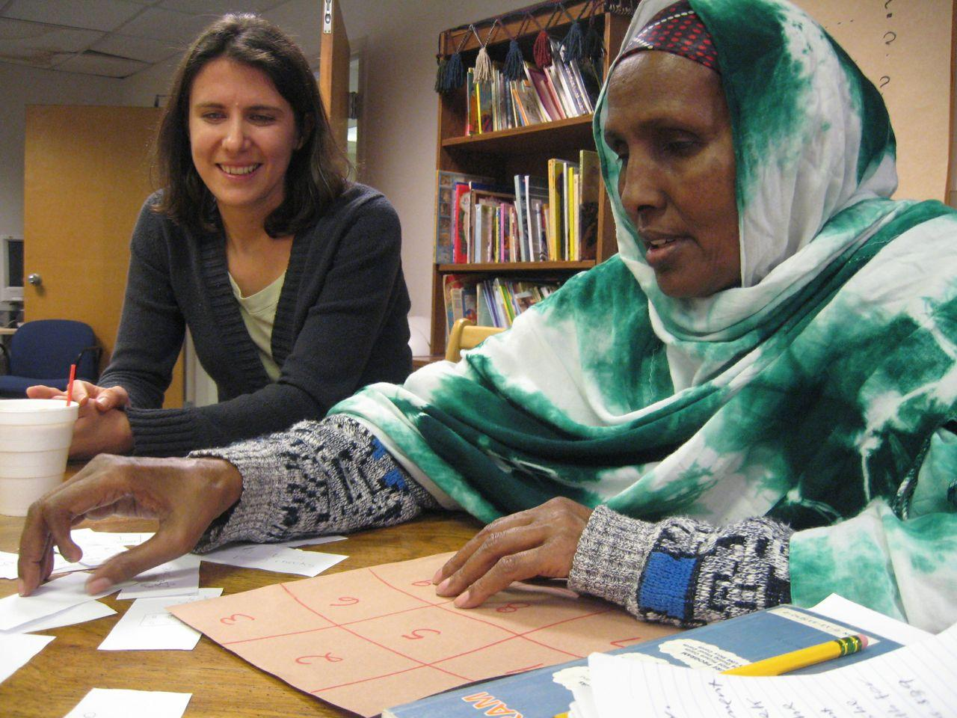
Engaging Parents: TIPS
Family Engagement
Visit school and experience routine
Explain the system: standardized
testing, field trips, calendars, notes
Ask parents to serve in expert roles, especially if they can’t help students with homework

Slide 36
Review
Understanding Resettlement and the Refugee Experience
Cultural Competency
Understanding Trauma
Working with EL Students
Strategies in the Classroom
Family Engagement

Slide 37
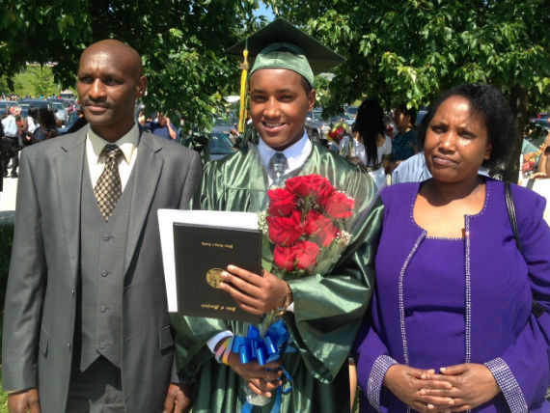
Questions?
classroom.therefugeecenter.org

Slide 38
Acknowledgments
Bassam Abdulsula, refugee
Mehret Agedsom, MA, teacher and refugee
Jessica Autrey, MA & MPH, teacher
Katie Chambers
Sharon Fink, ESL tutor/volunteer
Sarah Gaither, MA, Curriculum Development
Osob Issa, MSW
Wanjiru Kamau, PhD
Sissy Kegley, TESOL and MA
Thao La, Catholic Charities
Tej Mishra, MPH/MS, refugee from Bhutan
Lana Radosavljevic, MA
Erik Siehl, NBCT
Sarah Weiss, MA, former teacher
Kevin Wong, PhD

