Slide 1
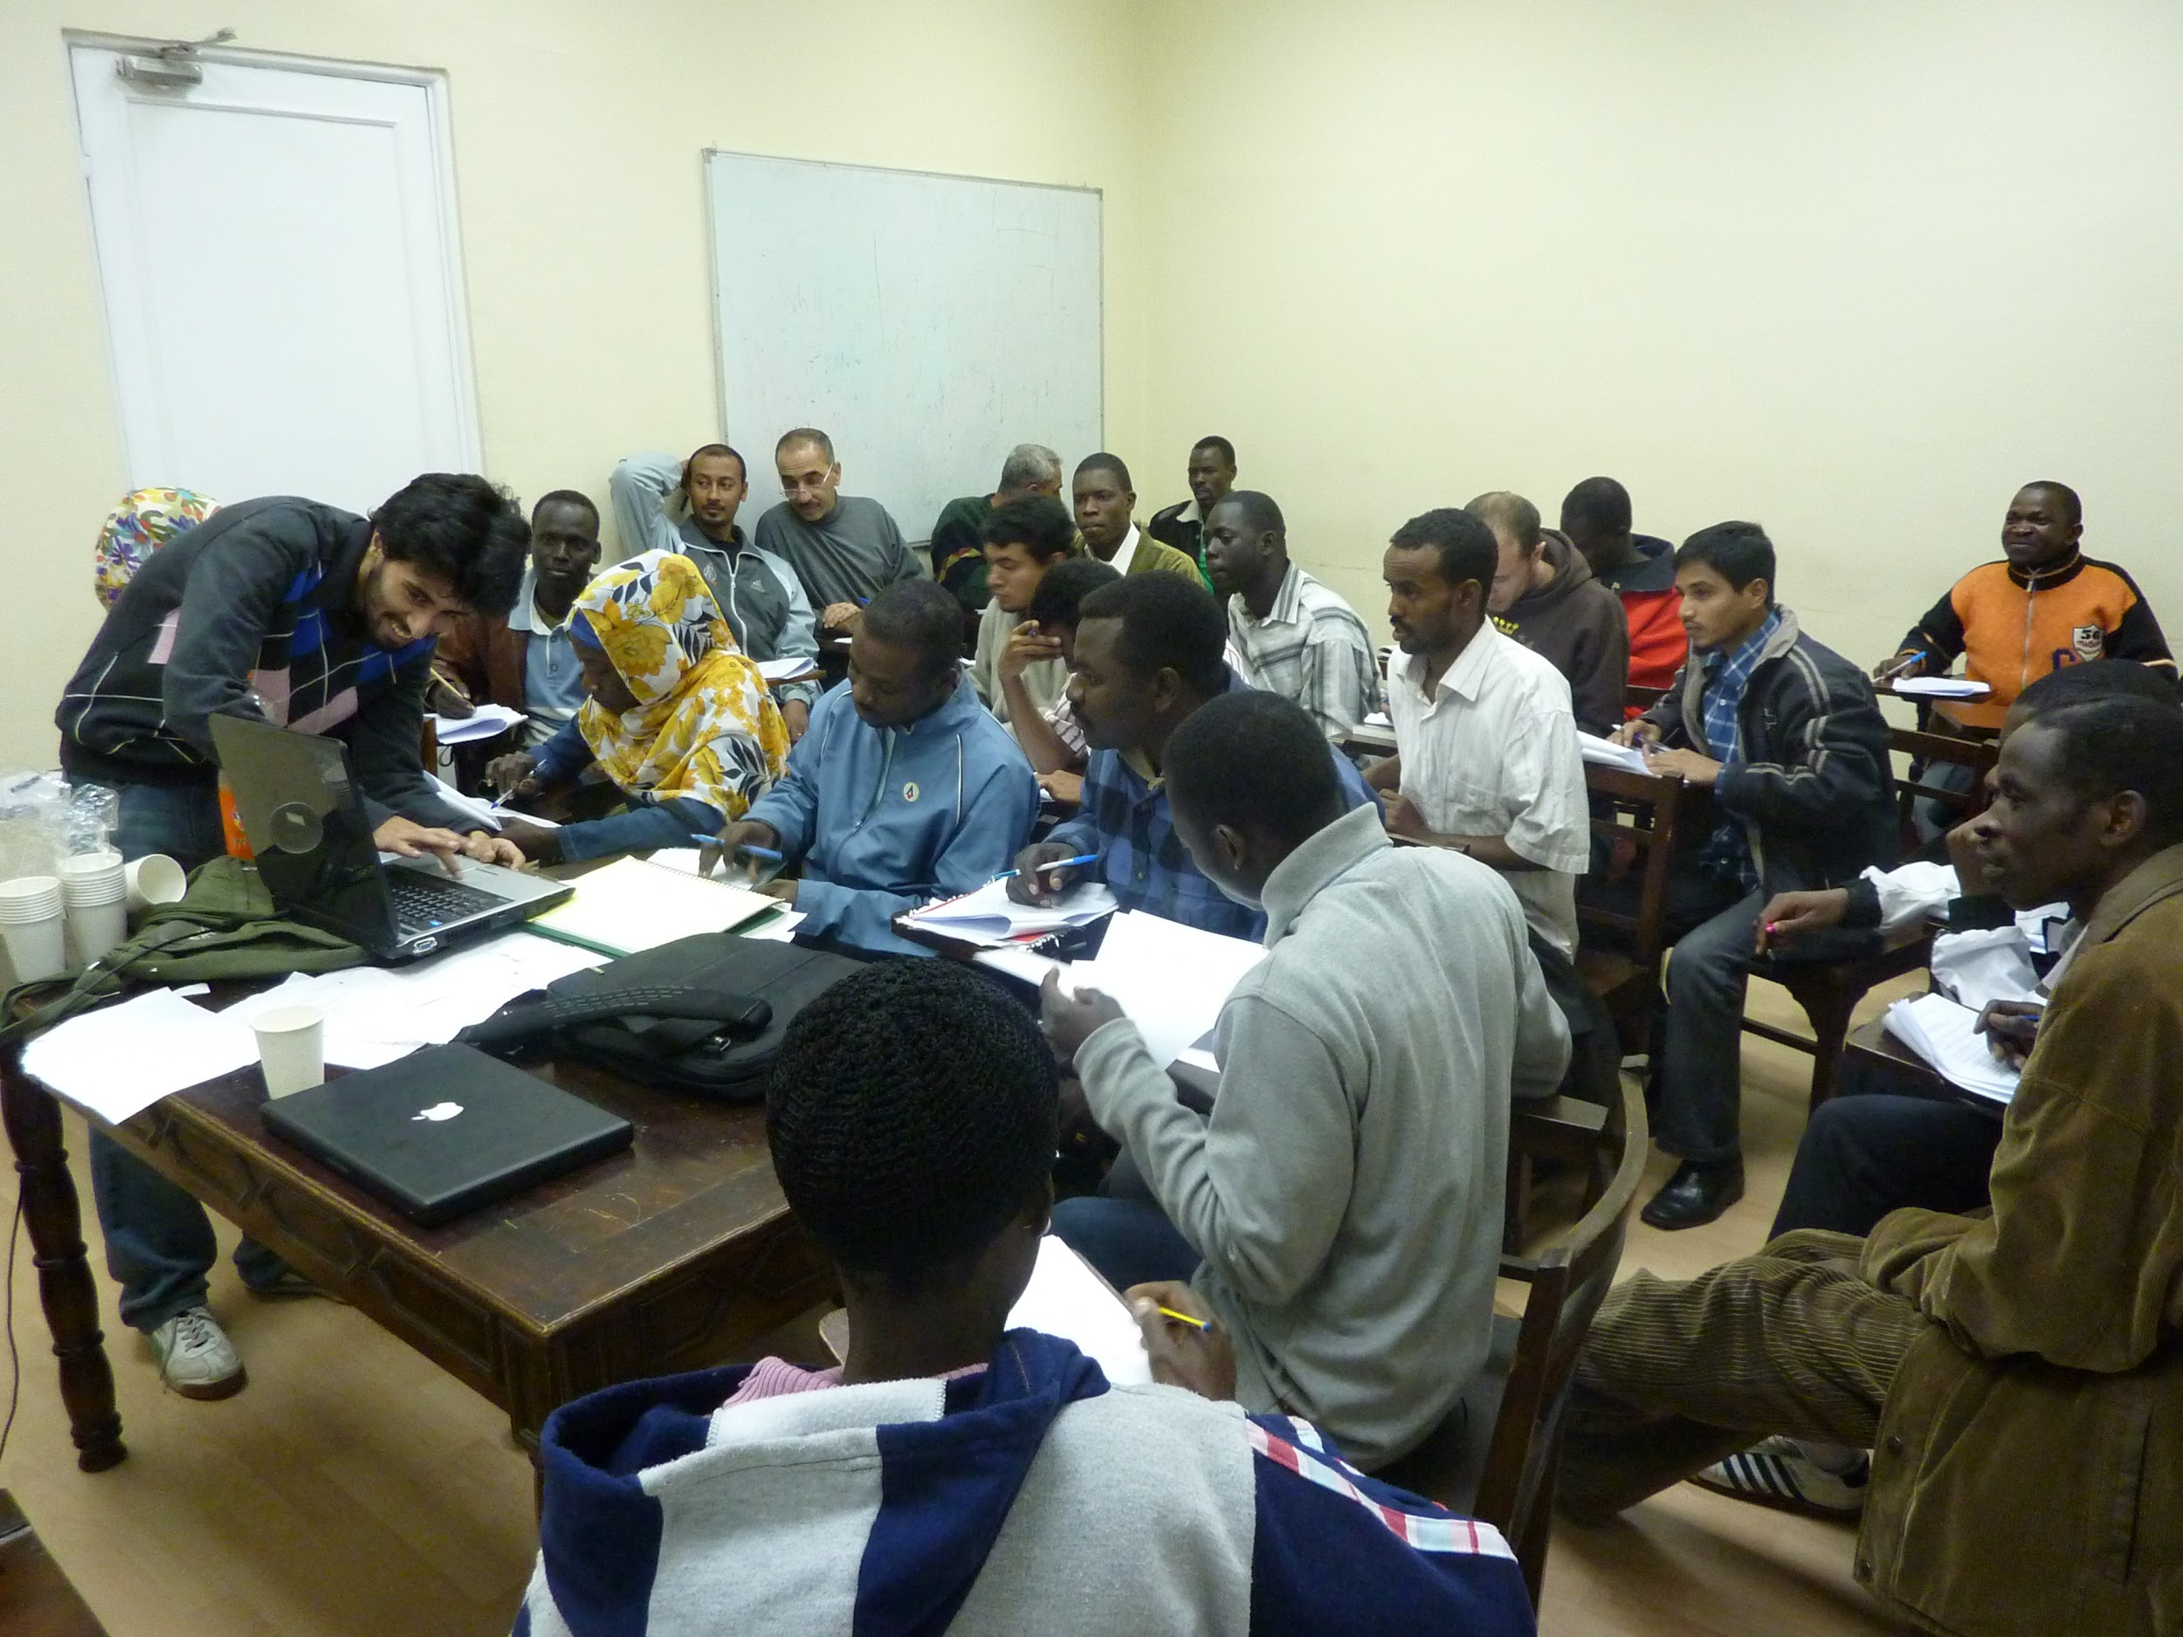
Lana Radosavljevic, MA
Jessica Marks, MPA

Slide 2
Overview
What Do You Want to Learn Today?
Insights from Our Needs Assessment
The RCO’s Approach
Best Practices for Your Organization
Questions?

Slide 3
The RCO
hs://vimeo.com/133312194ttp

Slide 4
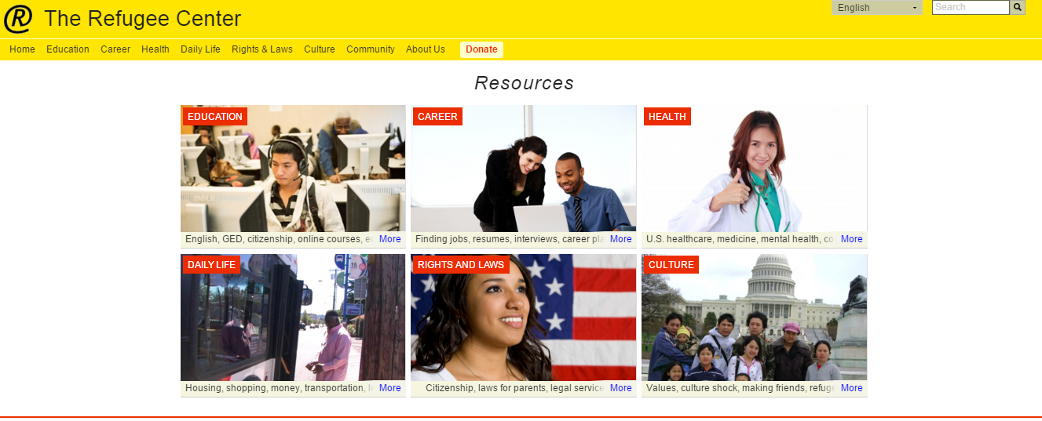
The RCO

Slide 5
Needs Assessment: Over 100 Refugees
Understanding Resettlement and the Refugee Experience
Afghani
Bhutanese
Congolese
Ethiopian
Karen
Iraqi
Nepali
Somali
Tibetan

Slide 6
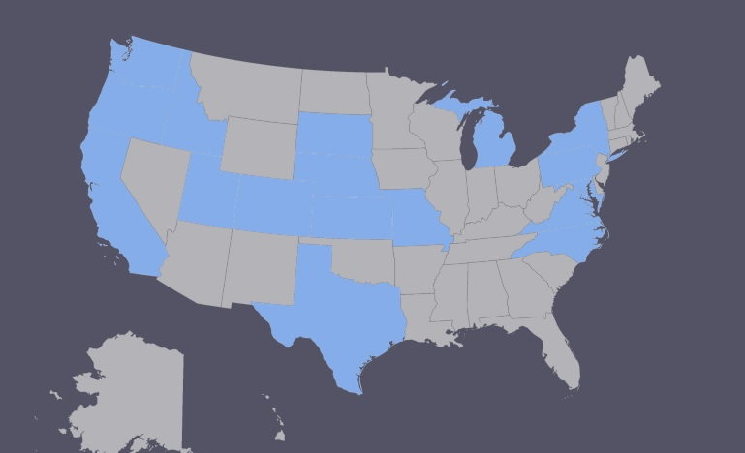
Needs Assessment: 18 States

Slide 7
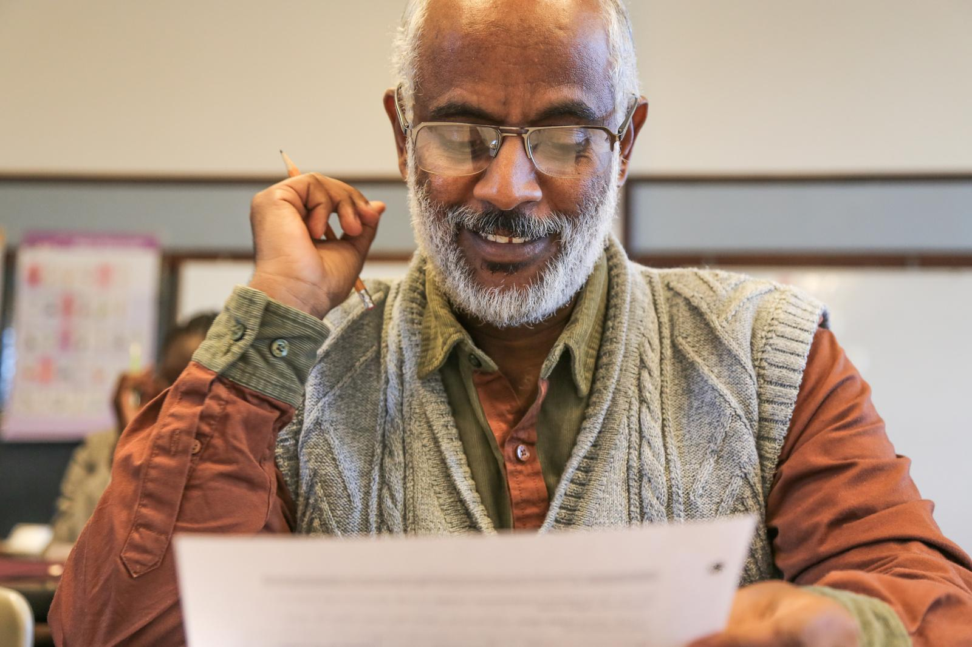
Needs Assessment
Age Range: 16-70
Time in US:
5 Months -
15+ Years
Photo copyright Molly Haley.

Slide 8
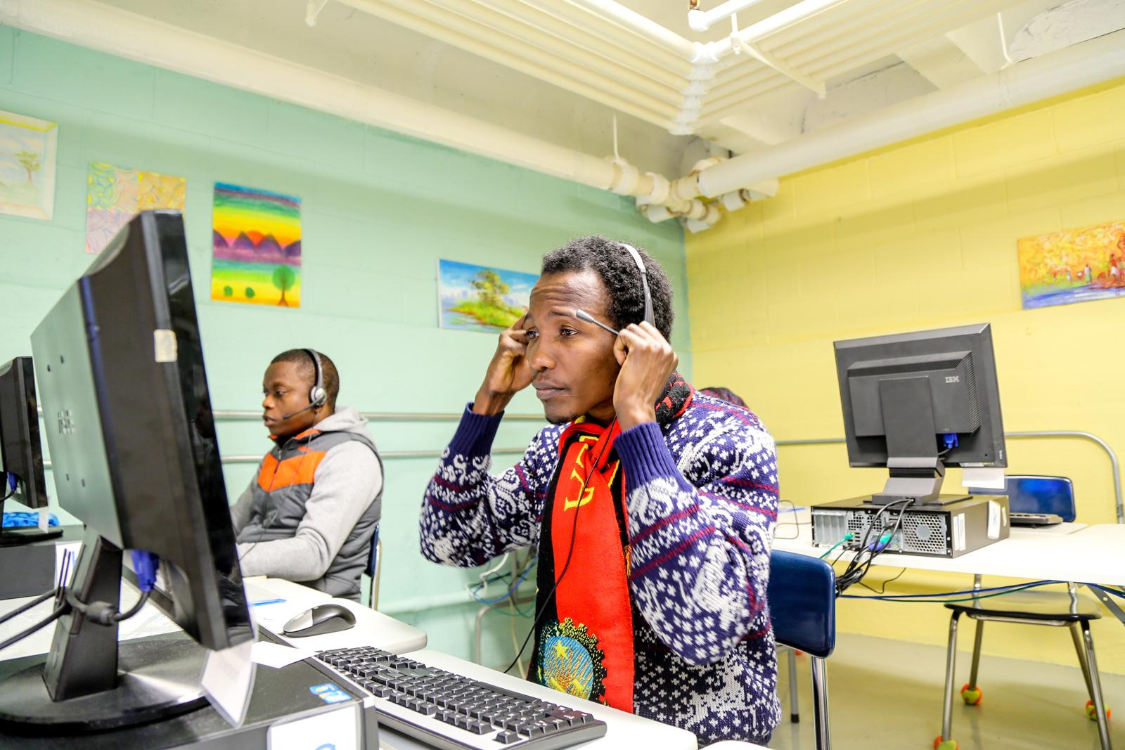
Needs Assessment
-Over 50% of Refugees Used a PC 1X Day

Slide 9
Needs Assessment
-Less than half of refugees felt well-informed about life in the US or well-connected to resources

Slide 10
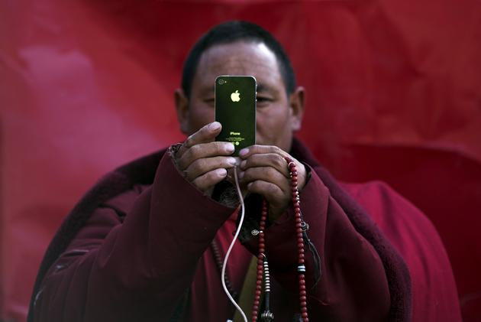
IN Addition
-Newcomers most often access the internet on smartphones or on public pcs
-Newcomers use smartphones at rates nearly equal to American-born citizens
Photo by Damir Sagolj
Notes:
“Privilege Walk”

Slide 11
The RCO’s Approach
Mission:
The RCO uses technology to facilitate successful resettlement transitions by strengthening access to resources and helping refugees build community through shared resources.

Slide 12
The RCO’s Approach
Our Users

Slide 13
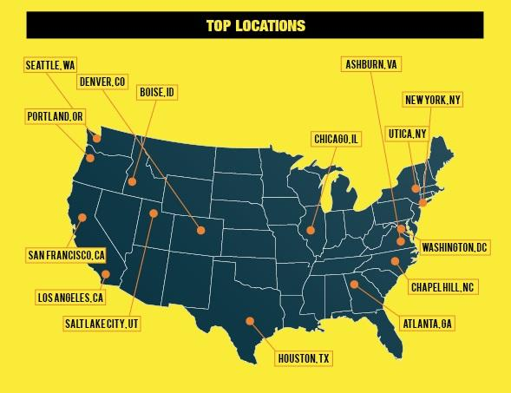
The RCO’s Approach

Slide 14
Our Programs
RESOURCES
Education
Career
Health
Daily Life
Rights & Laws
Culture

Slide 15
Our Programs
RESOURCES
Local Resource Database

Slide 16
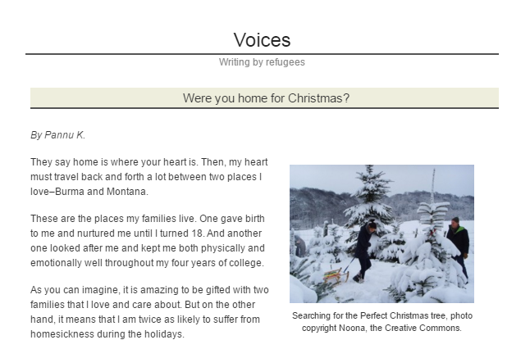
Our Programs
COMMUNITY
Connecting Refugees to One Another and Other Americans

Slide 17
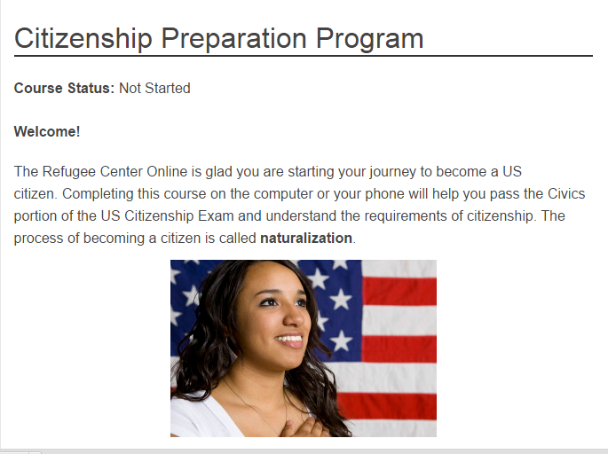
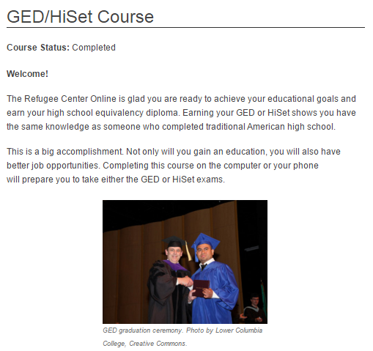
OUR PROgrams
CLASSROOM
Citizenship Preparation
GED/HiSet Preparation

Slide 18
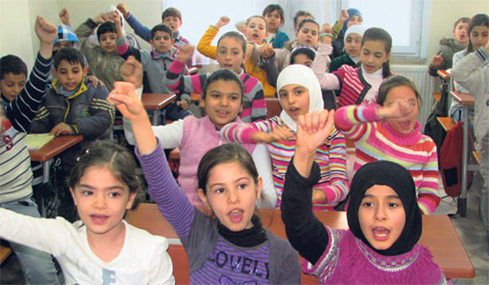
Our Programs
Teacher Training Course
Goals: Refugee students will excel and flourish in American schools. Teachers of refugees will not only be prepared to work with refugee youth, but will see refugees as valuable additions to their classrooms. Refugee families will feel connected to American schools.

Slide 19
OUR DESIGN
Mobile Friendly: easily viewable in both formats
Reading level: simple terms created by systems
Information architecture: easy navigation
Related information: pages pull in related content
Automated Feed for News: more current content
Search engine optimization: maximized search terms allowing site to be found online

Slide 20
Top languages

Slide 21
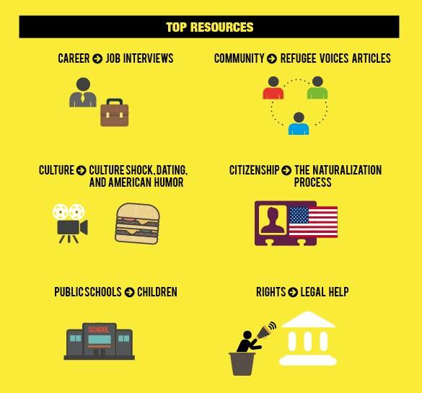

Slide 22
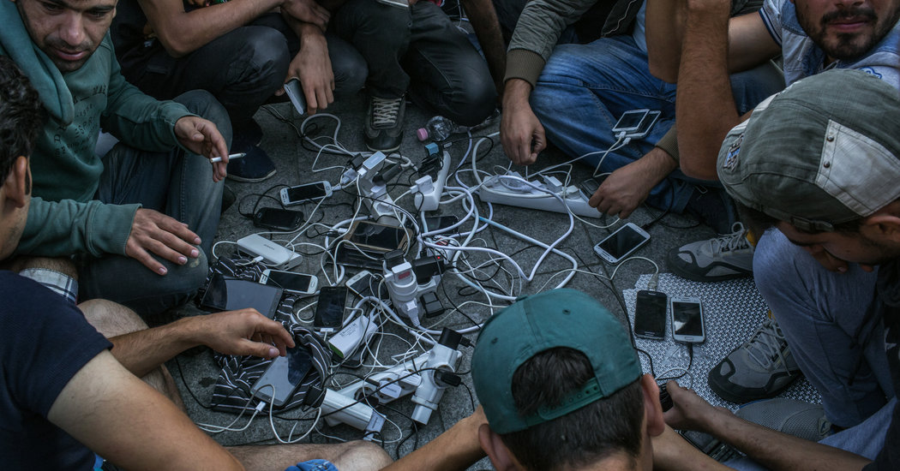
“Smart phones save Lives”
https://www.youtube.com/watch?v=RYTo9ItL0zk&app=desktop

Slide 23
HELPFUL APPS: ANKOMMEN
Provides guidance on the asylum process, a basic language course, information on finding training and work, and a section on German rules, values and culture.
Offered in Arabic, Farsi, English, French, and German

Slide 24
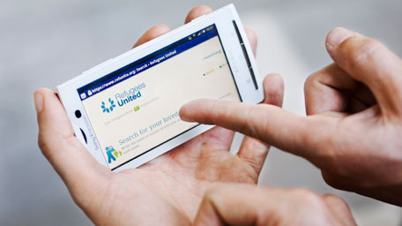
HELPFUL APPS: REFUGEES UNITED
Refugees United mission: To reconnect refugees with their families, wherever they might be
Users can create a profile and search for family or friends in the Refugees United Database

Slide 25
Other Examples OF APPS
Viber
Avacado
Pair
KIK
Voxer
Tango
Oovoo
Whats App

Slide 26
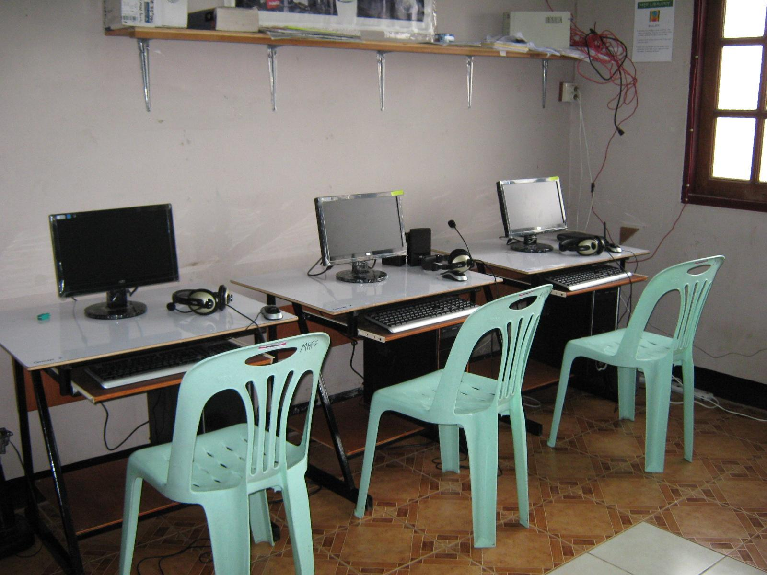
Tips for your organizations
-Avoid Log-ins
-Avoid PDFs
-Use Handwriting
-Choose Bright Colors
-Engage families
-Translate Materials
-Use Podcasts
Notes:
Avoid Log-ins (case workers tell them not to share personal info)

Slide 27
Tips for your Social Media
Popular topics:
-Positive stories about other refugees
-Positive news from their home countries
-Educational opportunities
-Career opportunities
-Quotes and images
-Contests

Slide 28
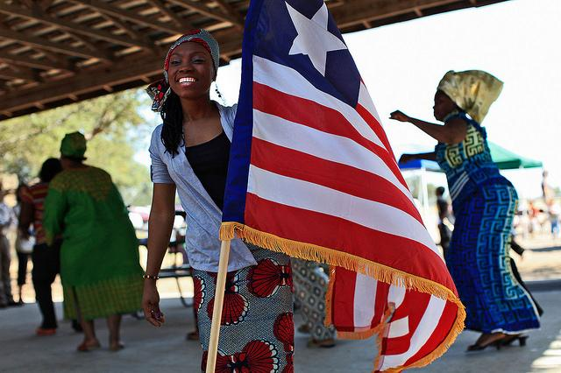
Break Out Sessions
Divide into groups and present answers.

Slide 29
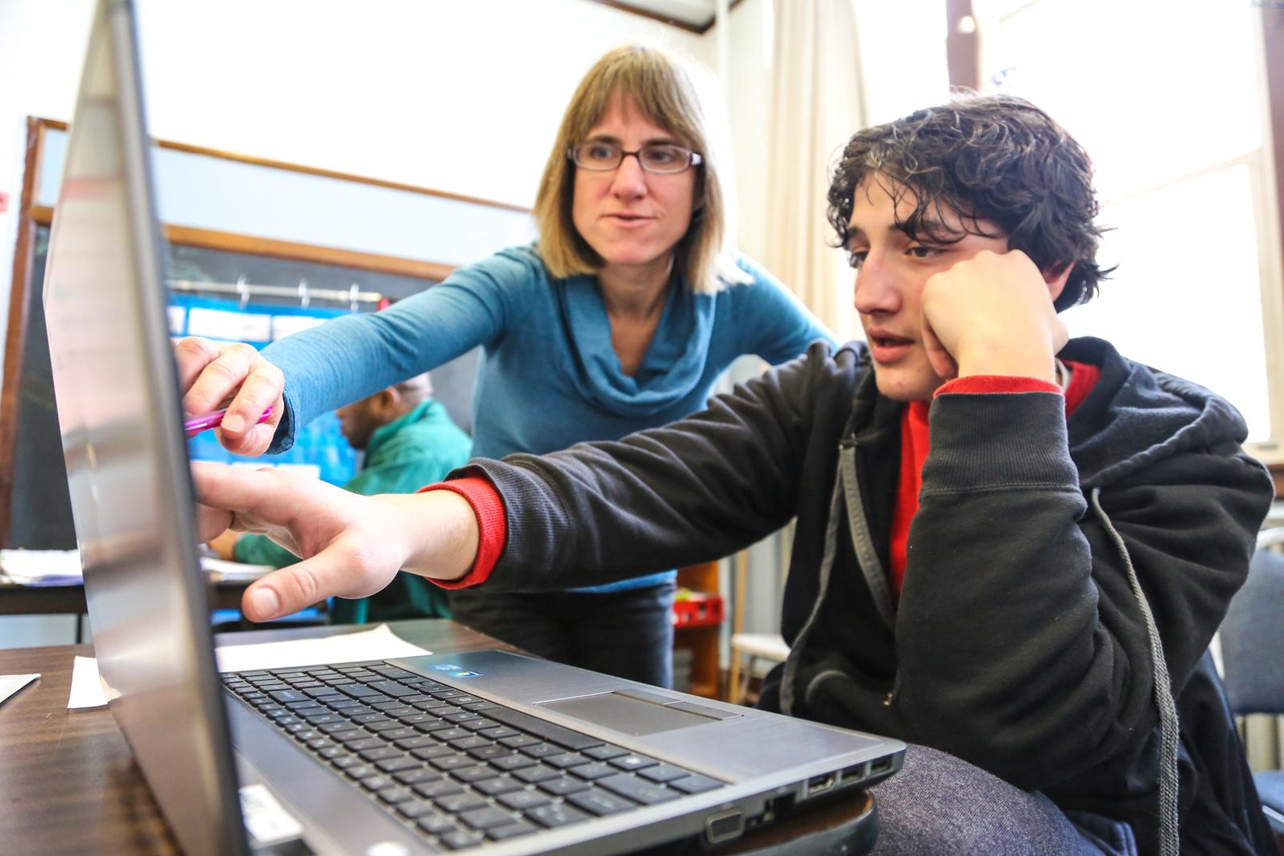
Questions?
Photo copyright Molly Haley.

